Slide 1
Properties of Sample SPACE
By Amrita Panjwani

Slide 2
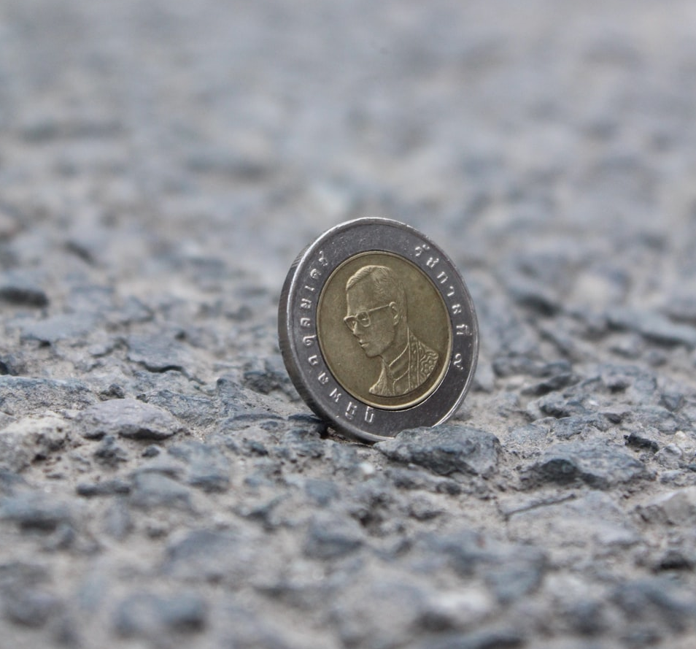
Let H denote the event that head shows up and T denote the event that tail shows up
If event H occurs, event T cannot occur. And if event T occurs , event H cannot occur.

Slide 3

When the occurrence of one event , guarantees the non-occurrence of another event they are called mutually exclusive.

Slide 4

If A and B are mutually exclusive events, this implies A and B cannot occur together
P( A and B) = 0

Slide 5
Lets check it out:
{1 ,2 , 3 , 4 ,5 6}

Slide 6

HEAD
TAIL
Let S = {H , T}
P(H) = ½
P(T) = ½
P(H) + P(T) = ½ + ½ = 1
P( S) = P(H) + P(T) = 1
Collectively exhaustive
Sum of probabilities of all elements of sample space is always 1.
This means it is sure that either of the elements of sample space will surely occur when the experiment is conducted.

Slide 7

{1 ,2 , 3 , 4 ,5 6}
(1/6) + (1/6) + (1/6) + (1/6) + (1/6) + (1/6) = 1
Sum of probabilities of all outcomes of sample space is always 1.
This makes the sample space exhaustive.

Slide 8


Outcomes: Head and Tail
Outcomes: 1, 2, 3, 4, 5, 6
Independent events

Slide 9
A bag contains 3 red and 2 blue marbles
Event A: select one marble from the bag
Event B: Select second marble from the same bag
The sample space for second event is dependent on first event
In this case the outcome of second event depends on outcome of previous event
Hence they are considered as dependent events

Slide 10
Dependent events
Independent events
Sample space
Sample space 1
Sample space 2
Event B
Event A
Event A
Event B

Slide 11

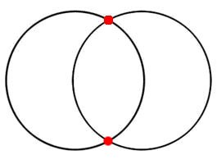
Joint events
A
B
Event A and event B have some common elements. This implies there is chance for the two events to occur together

Slide 12

Experiment: throw a dice Sample space: { 1, 2 , 3 ,4 ,5 , 6}
Event A: even number on dice
Event B: multiple of three on dice
6 is the common element
A
B
2
4
6
3
If 6 occurs, both events A and B occur together
Hence events A and B are joint events

Slide 13

Disjoint events
When two events A and B have no common elements. This implies when event A occurs, event B cannot occur
They are mutually exclusive

Slide 14
Experiment: throw a dice Sample space: { 1, 2 , 3 ,4 ,5 , 6}
Event A: even number on dice
Event B: odd number on dice
2
4
6
1
3
5
A
B
The two events A and B have no common elements
Hence events A and B are mutually exclusive events

Slide 15

Addition rule of probability
P(A or B)
P(A + B)
P(A U B)

Slide 16
A
B
When we add A and B , we see that the common region is counted twice
Hence when we need to find P(A or B) = P(A) + P(B)
- P(A and B)

Slide 17
Experiment: throw a dice
Sample space: { 1, 2 , 3 ,4 ,5 , 6}
Event A: even number on dice
Event B: multiple of three on dice
6 is the common element
P(A) = 3/6
P(B) = 2/6
P(A and B) = 1/6
P(A or B) = P(A) + P(B) – P(A and B)
P(A or B) = (3/6) + (2/6) – (1/6) = (3+2-1)/ 6 = 4/6
A
B
2
4
6
3

Slide 18
Addition rule of probability
Suppose there are 50 students one class
Computer
40 students
English
30 students
20 students took Computer and English both

Slide 19
computer =
40 students
English =
30 students
Both = 20 students
50 students

Slide 20

When the events are joint they have a common area that repeats twice and hence is subtracted once which calculating P(A or B)
But if the events are disjoint or mutually exclusive in that case the addition rule is simple sum of the probability of two individual events.
P(A or B) = P(A) + P(B) – P(A and B)
P(A or B) = P(A) + P(B)
A
B

Slide 21
Experiment: throw a dice
Sample space: { 1, 2 , 3 ,4 ,5 , 6}
Event A: even number on dice
Event B: odd number on dice
P(A) = 3/6
P(B) = 3/6
P(A and B) = 0
Hence
P(A or B) = P(A) + P(B)
P(A or B) = (3/6) + (3/6) = 1
2
4
6
1
3
5
A
B

Slide 22

The outcome of each
toss is independent

Slide 23

Multiplication rule for independent events
P(A and B)
P(A x B)
P(A ∩ B)

Slide 24
Multiplication rule for independent events
If A and B are independent events, then probability of A and B is obtained by multiplying the individual probability of event A and individual probability of event B
P(A and B) = P(A) * P(B)

Slide 25

A = toss a coin B = throw a dice
To find: P(H and 2)
Since the two events are independent
P(H and 2) = P(H) * P(2)
P(H) = 1 / 2 and P(2) = 1/6
P(H and 2) = 1 / 2 * 1 / 6 = 1/12

Slide 26
Conditional probability
In a scenario when some information about the selection is already given, based on that finding the probability of another event is called conditional probability.
Probability of A given B = P(A | B)

Slide 27
60% students select Mathematics and 40% select Computer Science. Out of those who select Mathematics 20% select English and out of those who select Computer Science 30% select English.
Given: P(M) = 0.60 P(C ) = 0.40
If a student has chosen M, then the probability of English is 20% , here a condition is already given, it is written as:
P(E | M) = 0.20
It is read as probability of English, given the student is from Mathematics
Similarly, P(E | C) = 0.30

Slide 28
Decision Tree
E
P( E|M) = 0.20
M
P( M) = 0.60
P( E'|M) = 0.80
Not E
Student
E
P( E|C) = 0.30
P( C ) = 0.40
C
P( E'|C) = 0.70
Not E

Slide 29
Multiplication rule based on conditional events
When A and B are not independent events, probability of A and B can be expressed with help of conditional probability
P(A and B) = P(A | B) * P(B)
Conditional probability of A [ P(A|B)] * probability of the condition [ P(B) ]

Slide 30
Multiplication rule
E
P(M and E) = P( E|M) * P(M)
= 0.20 * 0.60 = 0.12
P( E|M) = 0.20
M
P( M) = 0.60
P(M and Not E) = P( E’|M) * P(M)
= 0.80 * 0.60 = 0.48
P( E'|M) = 0.80
Not E
Student
E
P(C and E) = P( E|C) * P(C)
= 0.30 * 0.40 = 0.12
P( E|C) = 0.30
P( C ) = 0.40
C
P(C and Not E) = P( E’|C) * P(C)
= 0.70 * 0.40 = 0.28
P( E'|C) = 0.70
Not E

Slide 31

Formula of conditional probability
We know that P(A and B) = P(A|B) * P(B)
From this we get conditional probability as:
P(A|B) = P(A and B) / P(B)

